Slide 1
NeRF: Representing Scenes as Neural Radiance Fields
Володин Даниил 212

Slide 2
Content
Problem of view synthesis
Neural Radiance Field Scene Representation
Network
Volume Rendering and Expected Color
Intermediate results
Optimizations
Positional Encoding
Hierarchical volume sampling
Hyperparameters
Results and comparisons
Conclusion

Slide 3


1. Problem of view synthesis

Slide 4
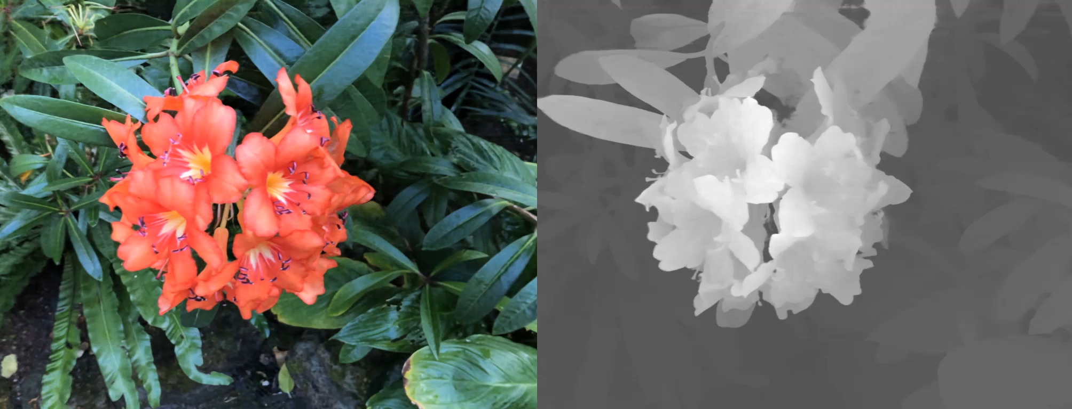

Slide 5
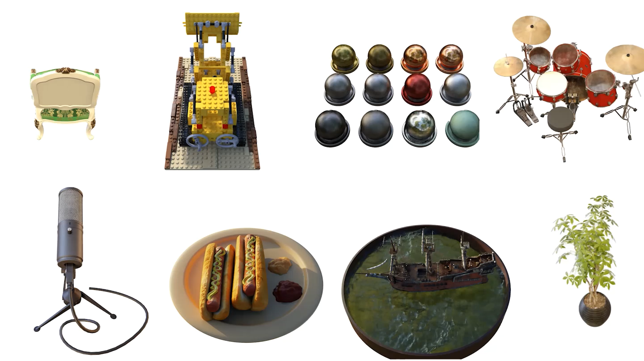

Slide 6
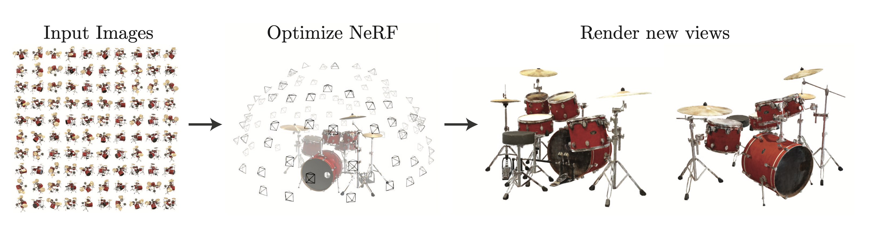

Slide 7
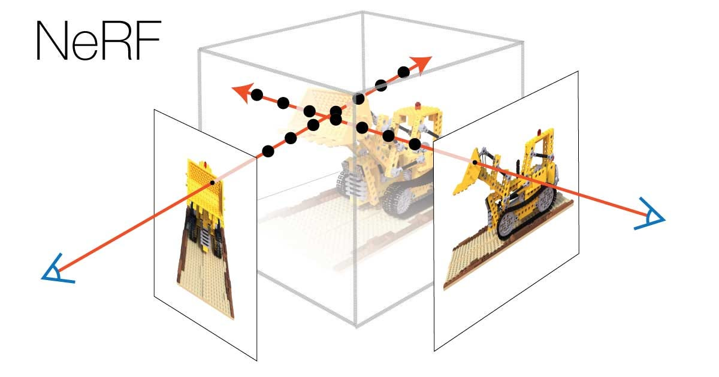
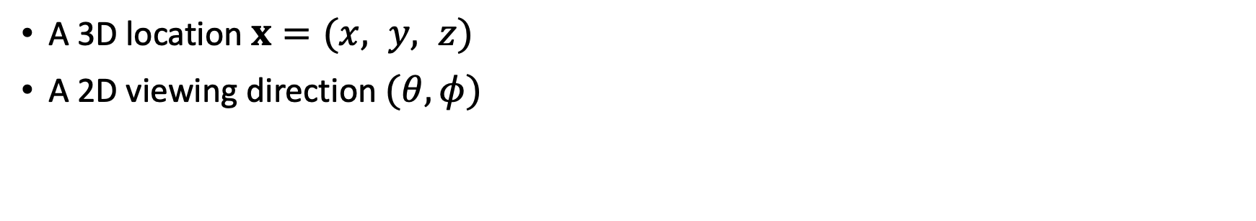
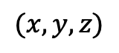
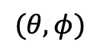
2. Neural Radiance Field Scene Representation
$$(θ, φ)$$
$$(x, y, z)$$
A 3D location $x=(x, y, z)$
A 2D viewing direction $(θ, φ)$

Slide 8
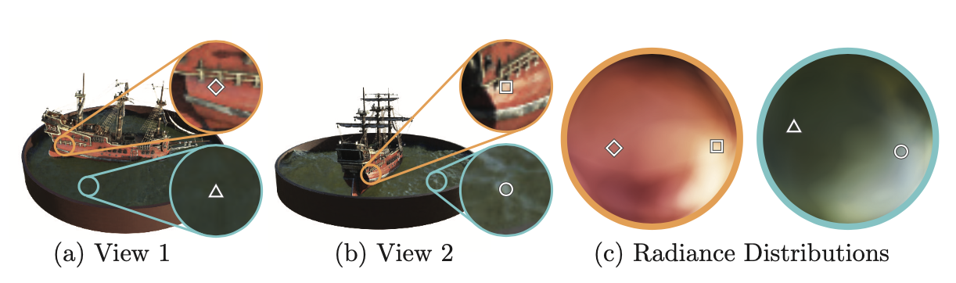
The purpouse of view direction
(a) and (b) are the appearance of two fixed 3D points from two different camera positions
The method predicts the changing specular appearance of the points (c)

Slide 9
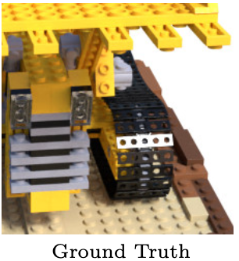
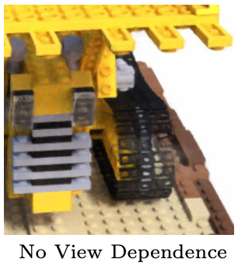

Slide 10
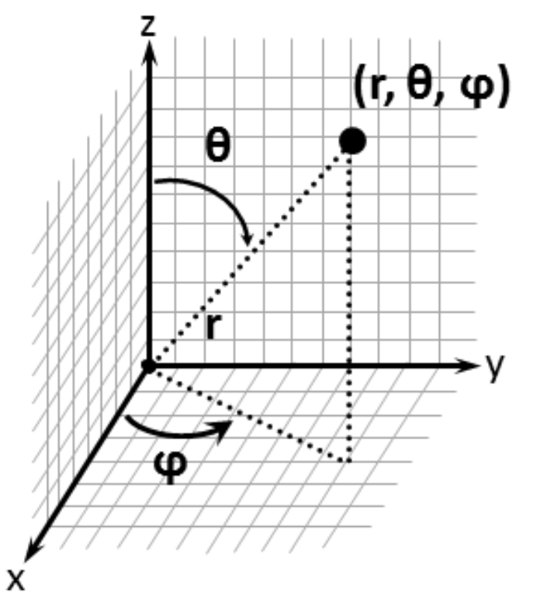
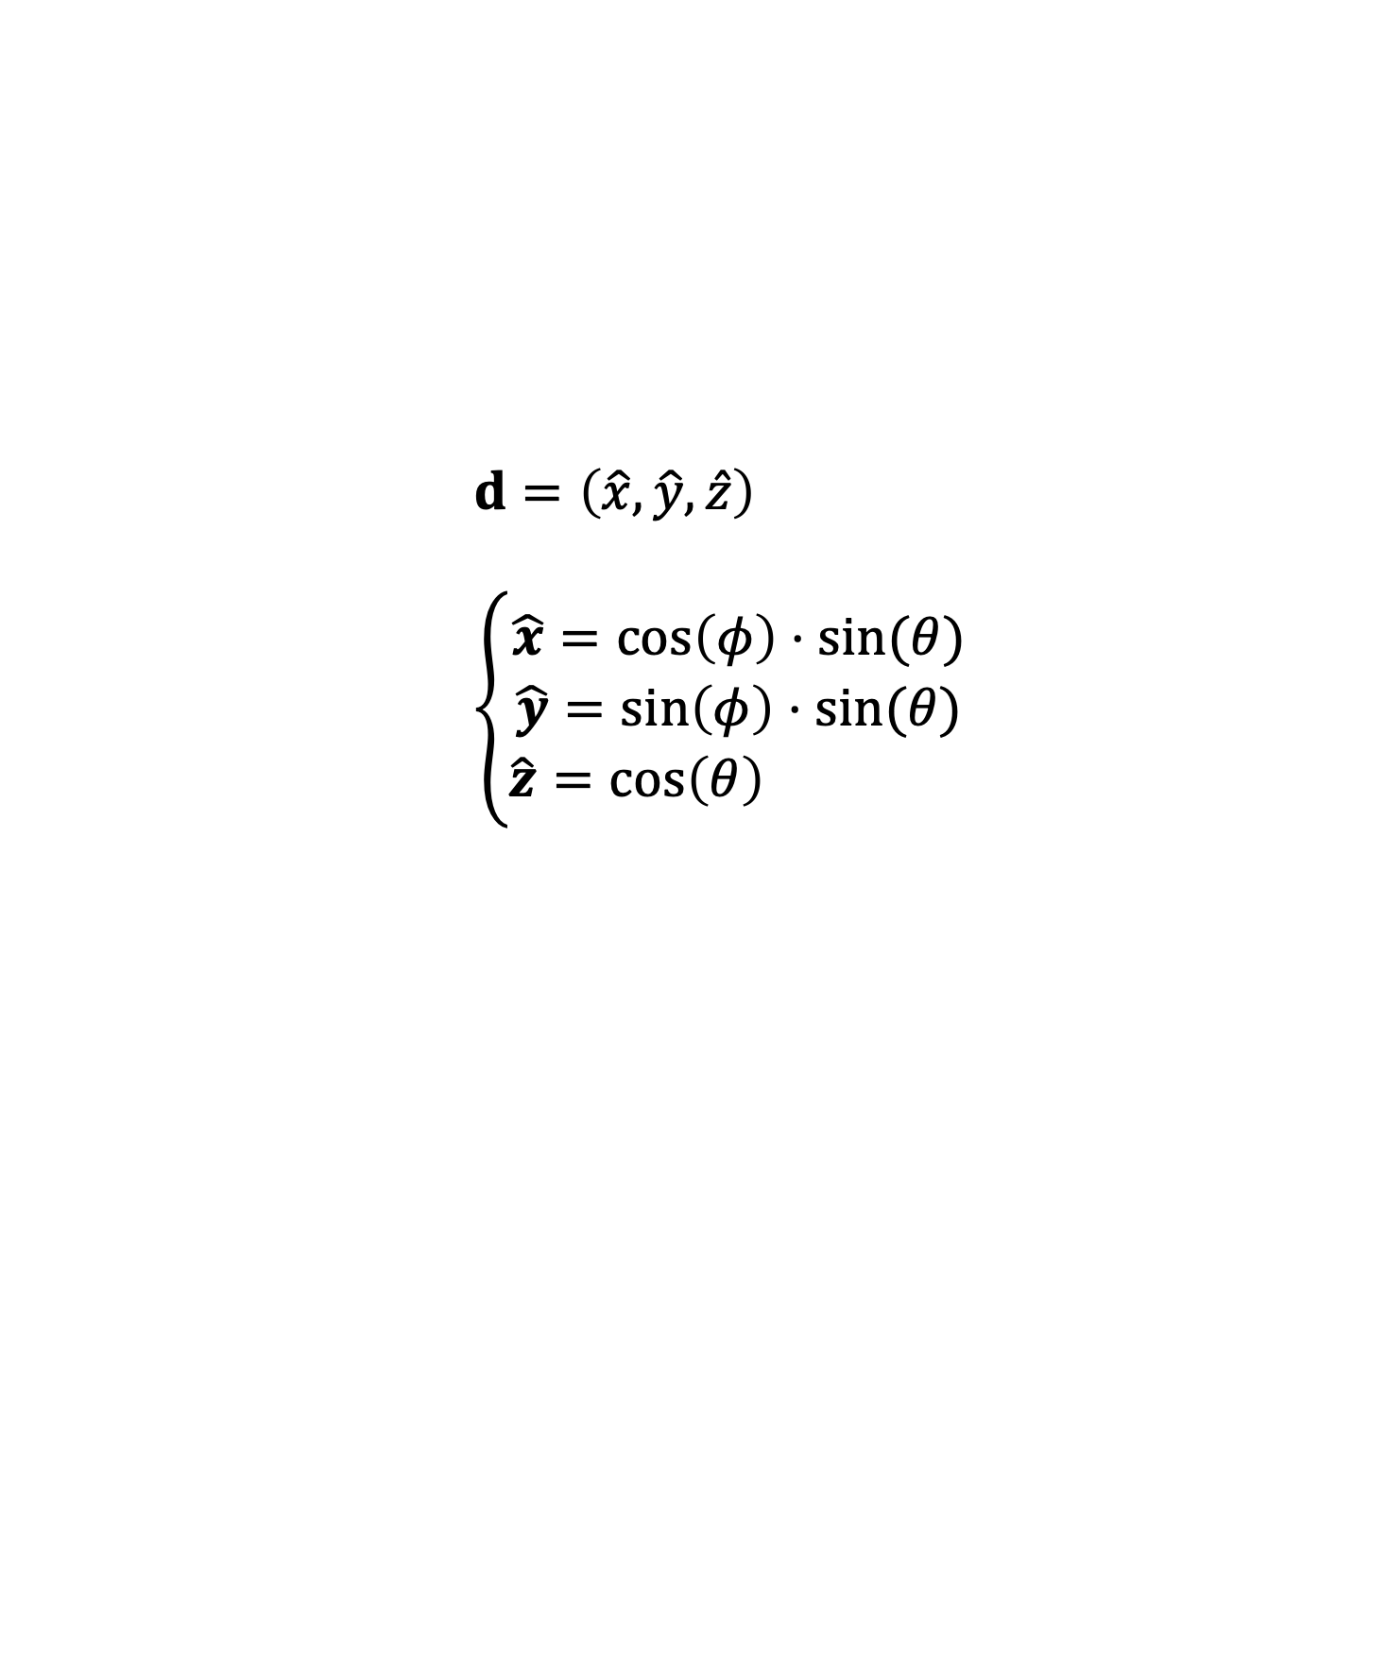
Viewing Direction
$$d=\left(\hat{x}, \hat{y}, \hat{z}\right)$$
$$\left\{\begin{aligned}\hat{x}=cos\left(φ\right)⋅sin⁡(θ) \\ \hat{y}=sin\left(φ\right)⋅sin(θ) \\ \hat{z}=cos\left(θ\right) \end{aligned}\right.$$
In practice, viewing direction $(θ, φ)$ is expressed as a 3D Cartesian unit vector $d$

Slide 11
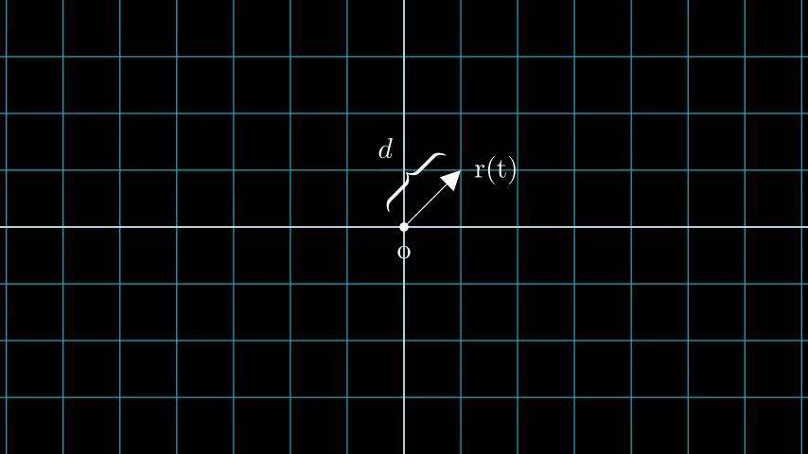
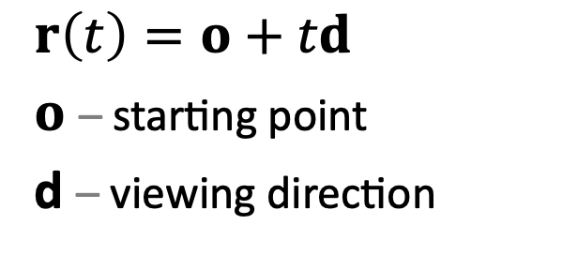
Viewing Ray
$$r\left(t\right)=o+td$$
$o$ – starting point
d – viewing direction

Slide 12
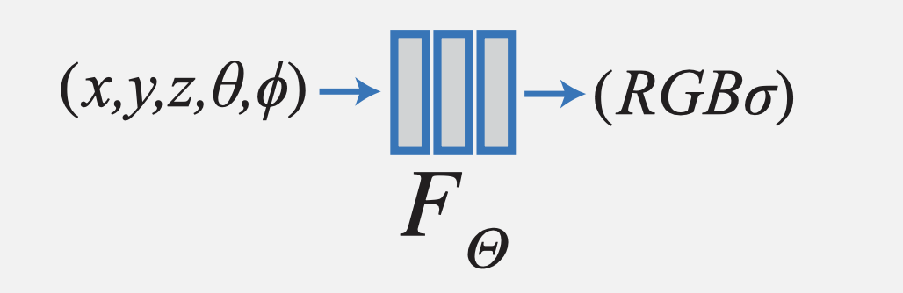
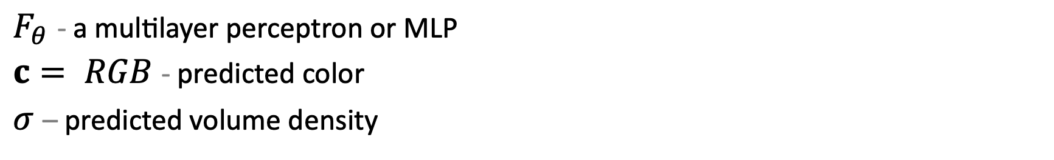
3. Network
Network is fitted to predict points of a single scene!
$F_{θ}$- a multilayer perceptron or MLP
$c= RGB$ - predicted color
$σ$ – predicted volume density

Slide 13
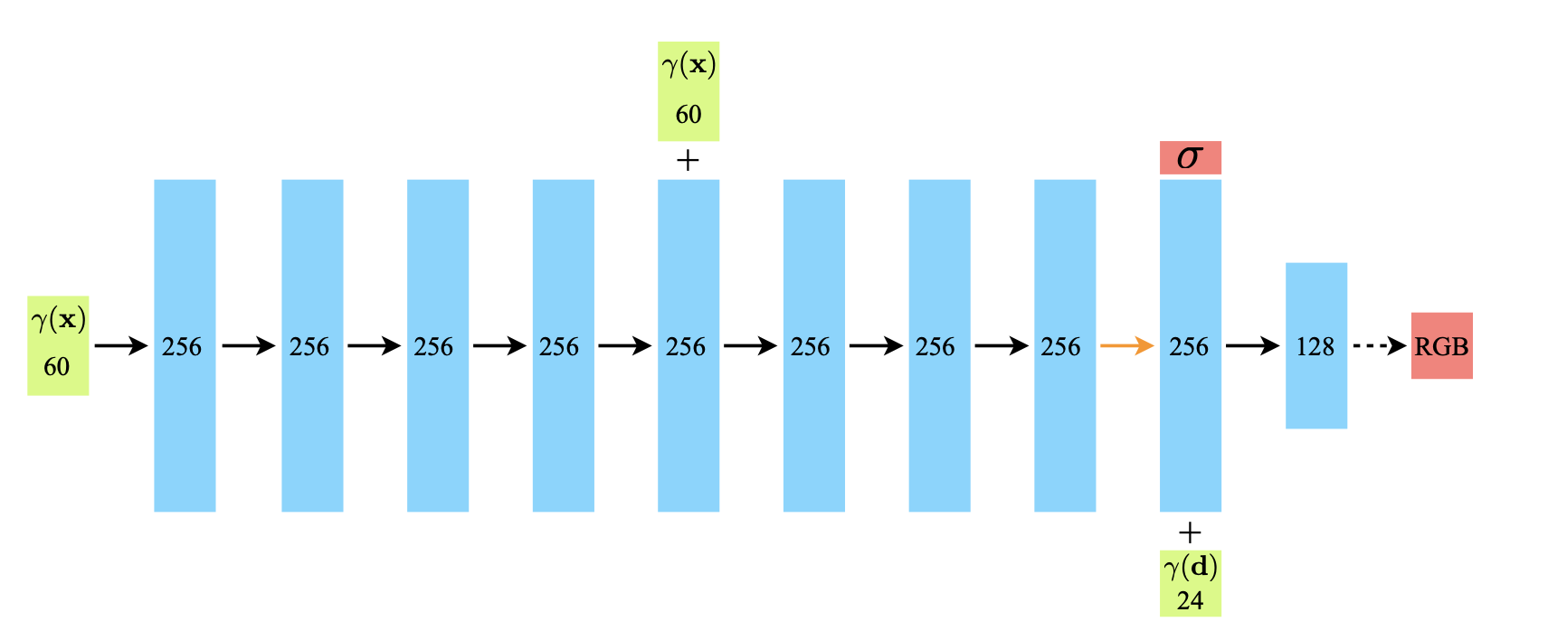

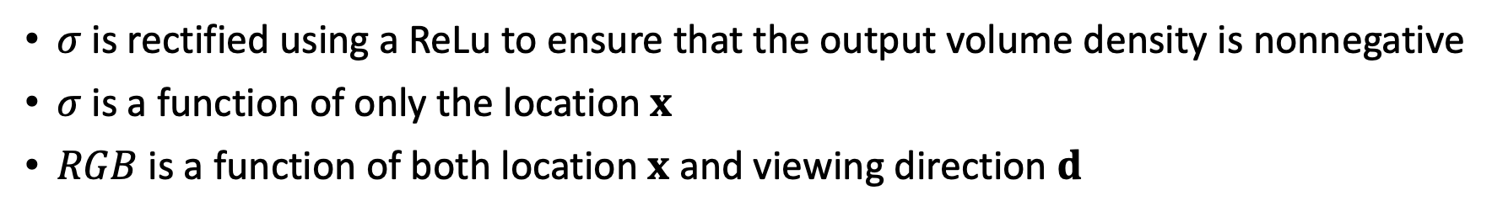
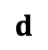
No activation
8 fully-connected layers with ReLu activation
Sigmoid activation
$$x$$
3
Concatenation
$$d$$
3
$σ$ is rectified using a ReLu to ensure that the output volume density is nonnegative
$σ$ is a function of only the location $x$
$RGB$ is a function of both location $x$ and viewing direction $d$

Slide 14
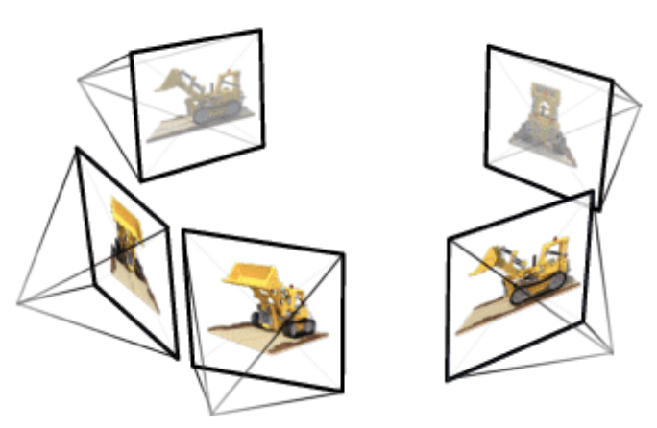
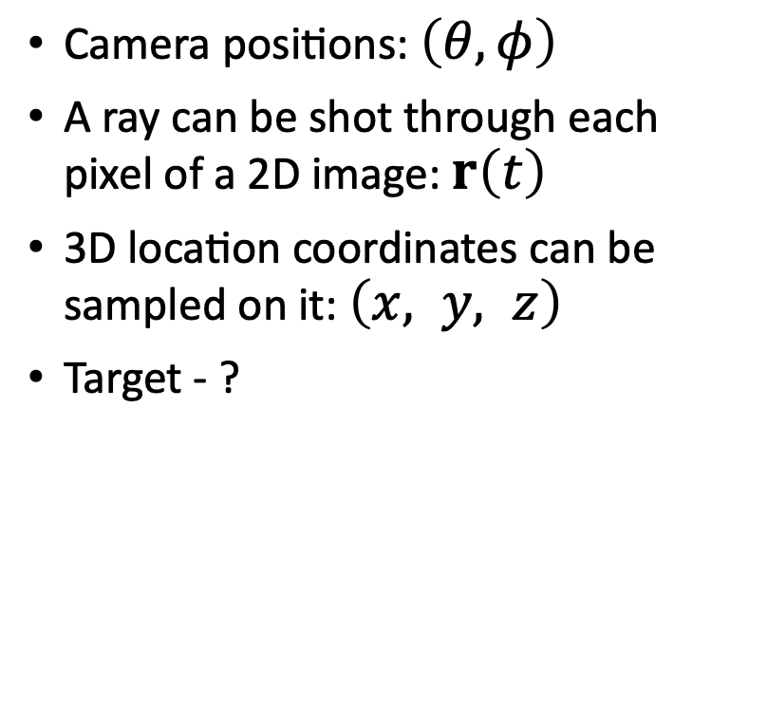
Training Data
Camera positions: $\left(θ, φ\right)$
A ray can be shot through each pixel of a 2D image: $r\left(t\right)$
3D location coordinates can be sampled on it: $\left(x, y, z\right)$
Target - ?

Slide 15
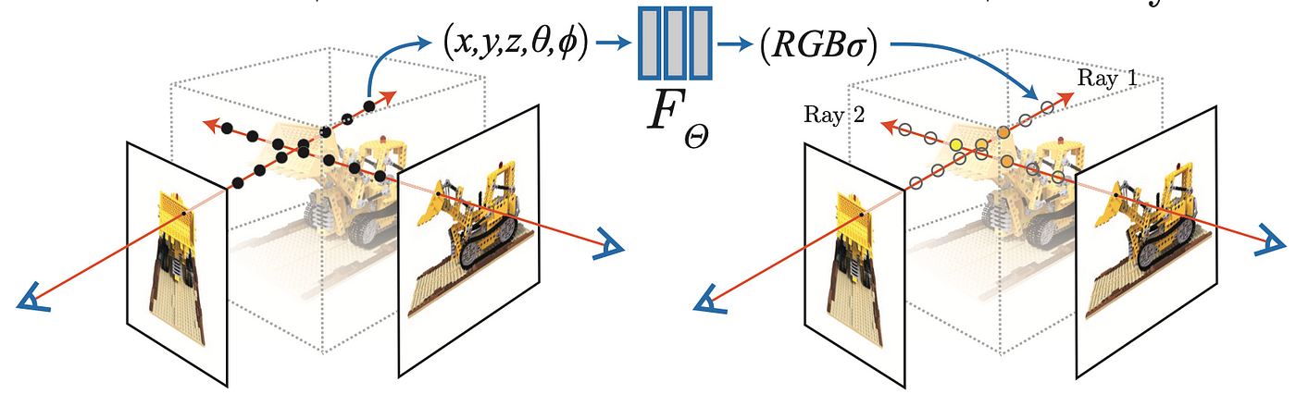
4. Volume Rendering and Expected Color

Slide 16
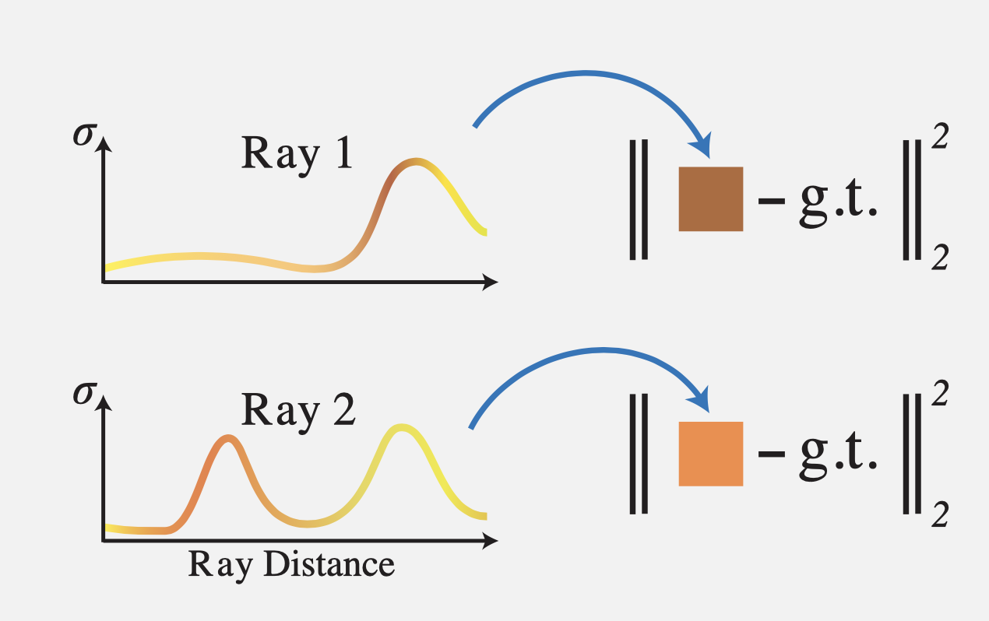
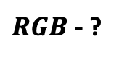
Volume Density
$RGB$ - ?
How to get the exact color that we see from the given direction on a 2D image?

Slide 17
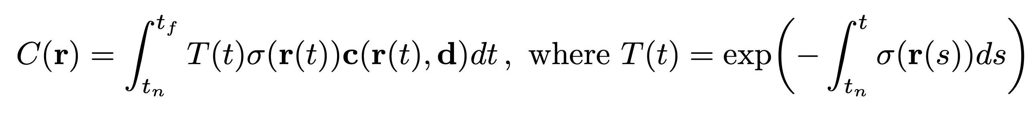
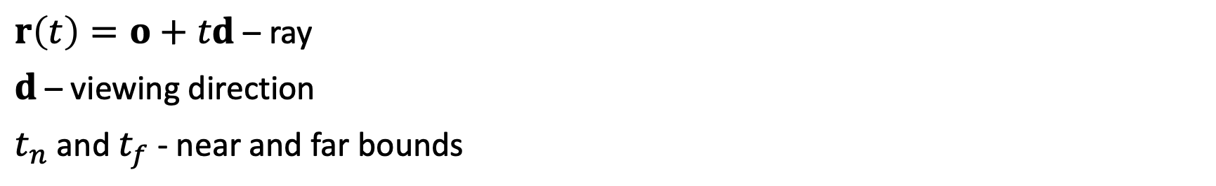

Volume Rendering¹
Probability that the ray travels from $t_{n}$ to $t$ without hitting any other particle
2D color
prediction
Density
(color weight)
Color prediction
in a 3D location
$r\left(t\right)=o+td$ – ray
$d$ – viewing direction
$t_{n}$ and $t_{f}$ - near and far bounds

Slide 18
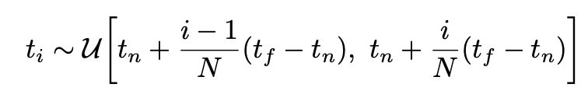
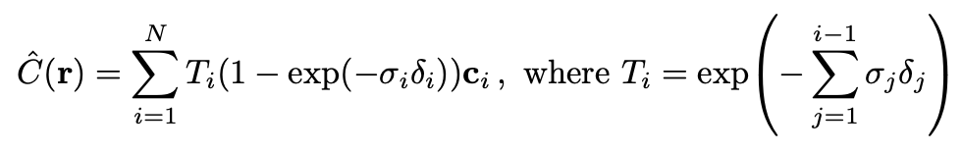
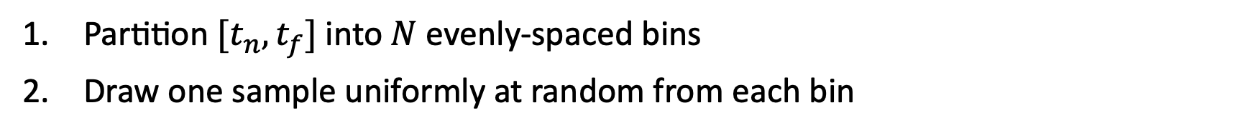
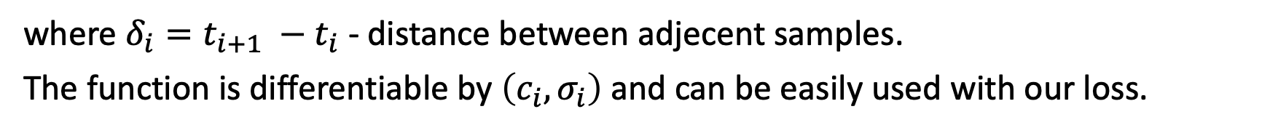
Numericall estimation
Partition ${[t}_{n}, t_{f}]$ into $N$ evenly-spaced bins
Draw one sample uniformly at random from each bin
Estimate $C\left(r\right)$ with quadrature rule²
where $δ_{i}=t_{i+1} −t_{i}$ - distance between adjecent samples.
The function is differentiable by $\left(c_{i}, σ_{i}\right)$ and can be easily used with our loss.

Slide 19
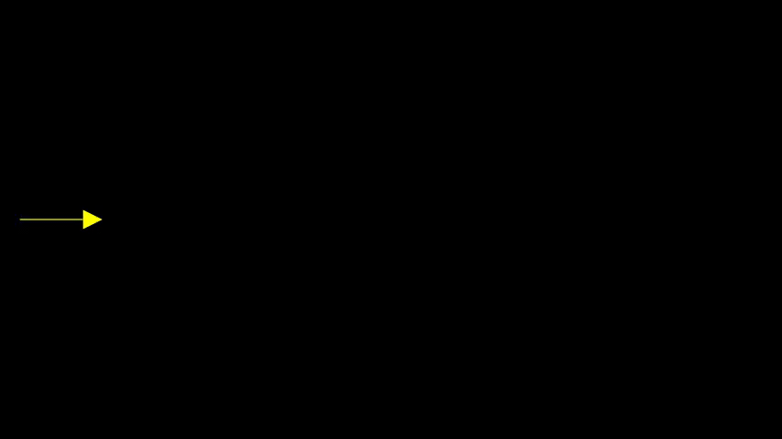

Slide 20
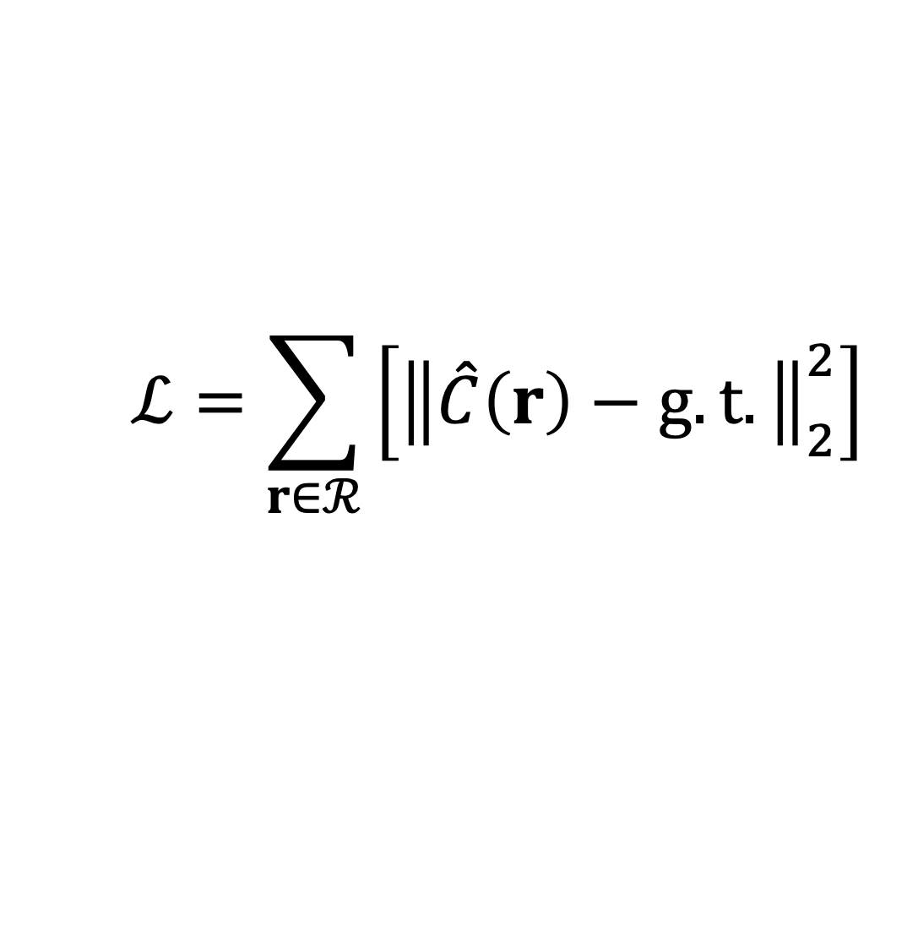
Loss function
$$ℒ=\sum_{r∈ℛ}{\left[{\left\|\hat{C}\left(r\right)−g.t.\right\|}_{2}^{2}\right]}$$

Slide 21
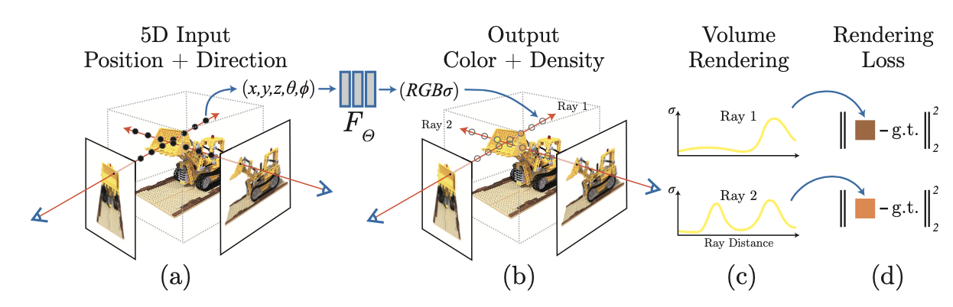
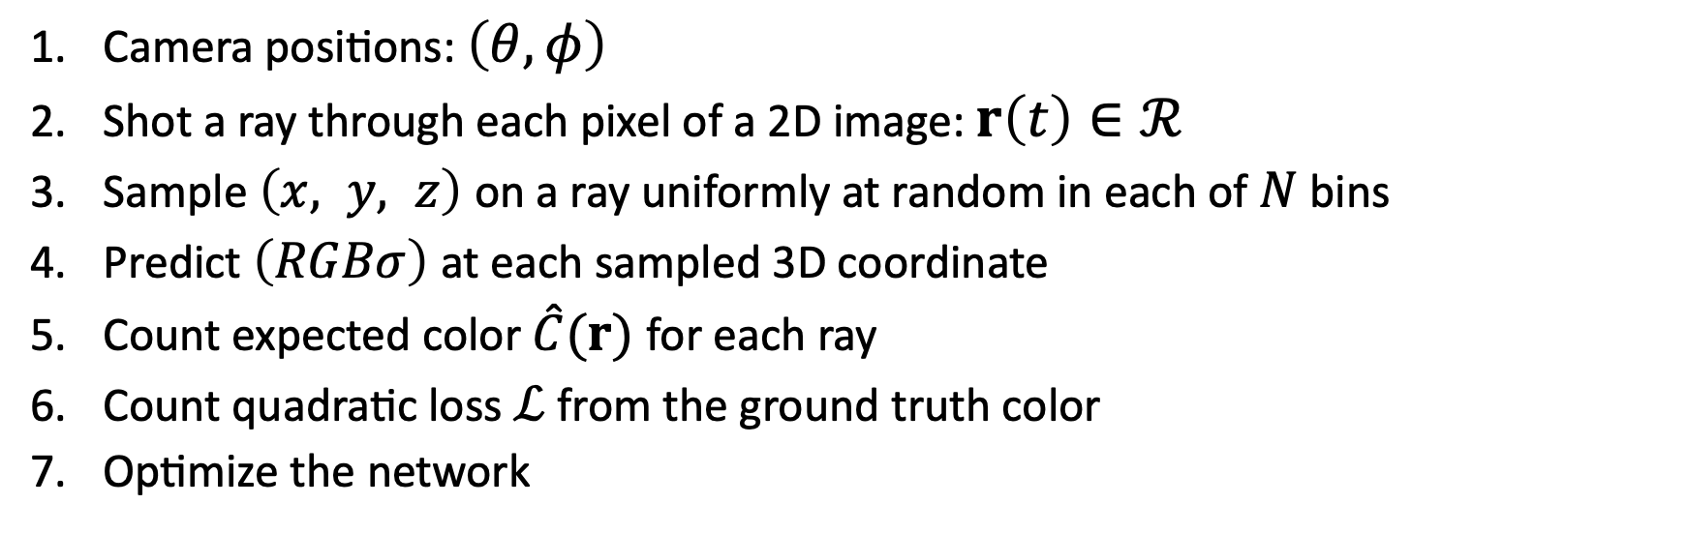
Camera positions: $\left(θ, φ\right)$
Shot a ray through each pixel of a 2D image: $r\left(t\right)∈ℛ$
Sample $\left(x, y, z\right)$ on a ray uniformly at random in each of $N$ bins
Predict $\left(RGBσ\right)$ at each sampled 3D coordinate
Count expected color $\hat{C}(r)$ for each ray
Count quadratic loss $ℒ$ from the ground truth color
Optimize the network

Slide 22
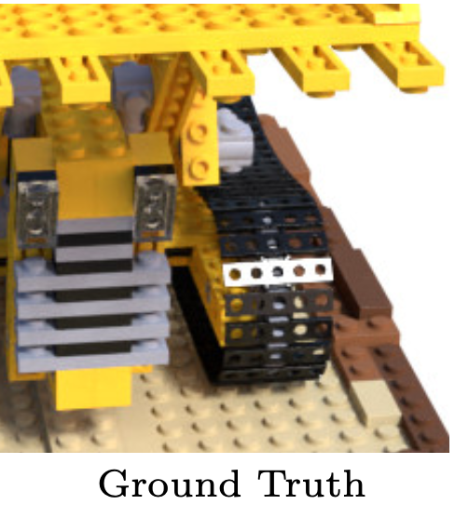
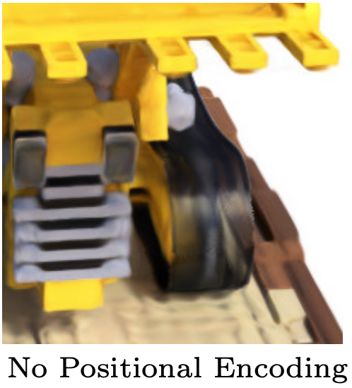
5. Intermediate Results

Slide 23
6. Optimizations
Postional Encoding
Hierarchical volume sampling

Slide 24
6.1. Positional Encoding
Issue: current model is unable to represent high-frequency changes in the scene
Solution³: map the inputs to a higher dimesional space using high-frequency functions

Slide 25
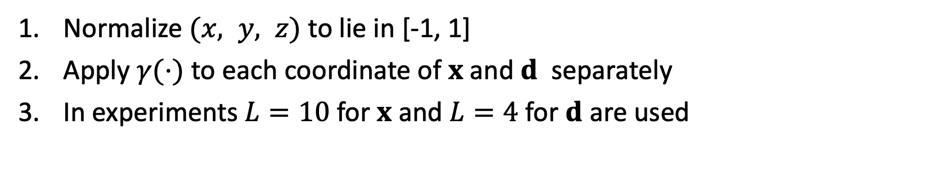
Solution
Normalize $(x, y, z)$ to lie in [-1, 1]
Apply $γ(⋅)$ to each coordinate of $x$ and $d$ separately
In experiments $L=10$ for $x$ and $L=4$ for $d$ are used

Slide 26
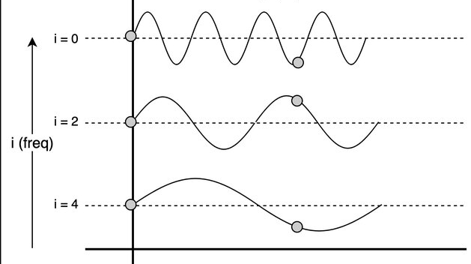
Example

Slide 27
New Architecture

Slide 28
6.1. Hierarchical volume sampling
Issue: current sampling of points is inefficient: free space and occluded regions do not contribute to the image but are still sampled repeatedly
Solution: optimize two networks: “coarse” and “fine”, so that points for the second one are sampled using the output of the “coarse” model

Slide 29
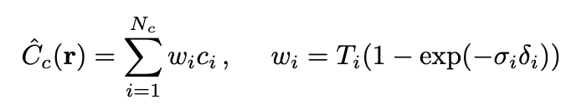
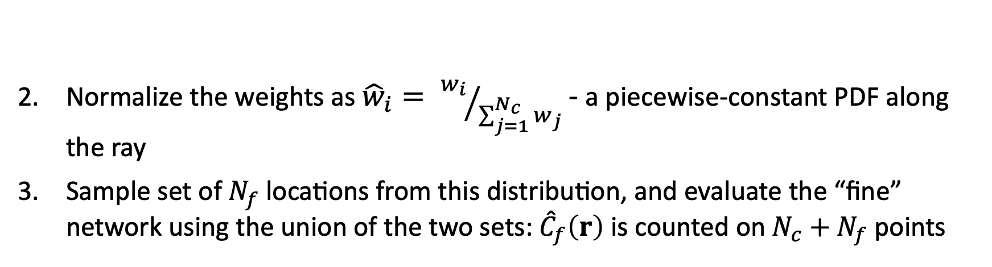
Solution
Sample a set of $N_{c}$ locations using stratified sampling, and evaluate the “coarse” network as before:
Normalize the weights as ${\hat{w}}_{i}= {w_{i}}/{\sum_{j=1}^{N_{c}}{w_{j}}}$ - a piecewise-constant PDF along the ray
Sample set of $N_{f}$ locations from this distribution, and evaluate the “fine” network using the union of the two sets: ${\hat{C}}_{f}\left(r\right)$ is counted on $N_{c}+N_{f}$ points

Slide 30
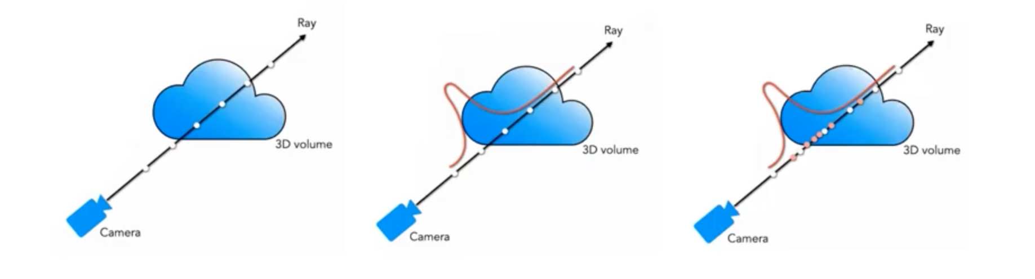

Slide 31
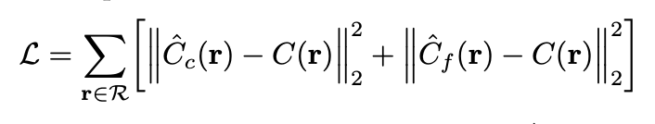
New Loss Function

Slide 32
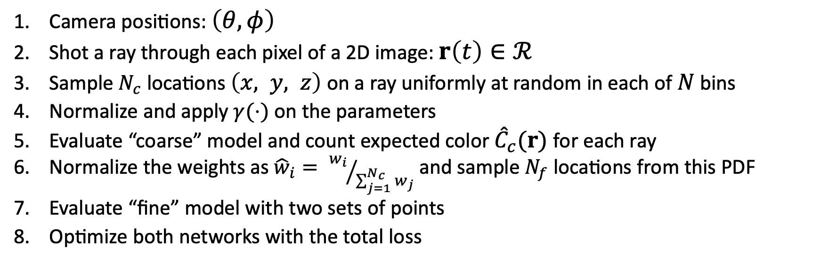
Camera positions: $\left(θ, φ\right)$
Shot a ray through each pixel of a 2D image: $r\left(t\right)∈ℛ$
Sample $N_{c}$ locations $\left(x, y, z\right)$ on a ray uniformly at random in each of $N$ bins
Normalize and apply $γ(⋅)$ on the parameters
Evaluate “coarse” model and count expected color ${\hat{C}}_{c}(r)$ for each ray
Normalize the weights as ${\hat{w}}_{i}= {w_{i}}/{\sum_{j=1}^{N_{c}}{w_{j}}}$ and sample $N_{f}$ locations from this PDF
Evaluate “fine” model with two sets of points
Optimize both networks with the total loss

Slide 33
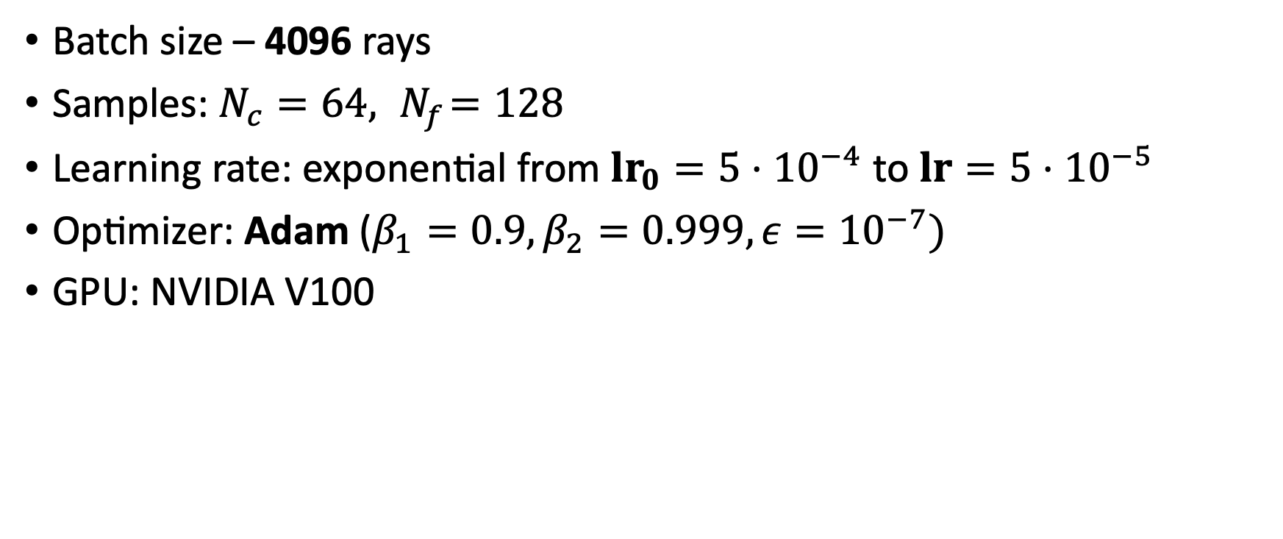
7. Hyperparameters
Batch size – 4096 rays
Samples: $N_{c}=64, { N}_{f}=128$
Learning rate: exponential from $lr_{0}=5⋅{10}^{−4}$ to $lr=5⋅{10}^{−5}$
Optimizer: Adam ($β_{1}=0.9, β_{2}=0.999, ε={10}^{−7})$
GPU: NVIDIA V100

Slide 34
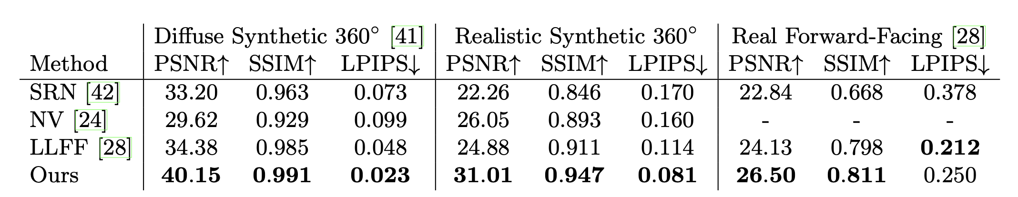
8. Results
2 types of datasets: synthetic renderings of objects and real images of complex scenes
Neural Volumes (NV) - deep 3D convolutional network
Scene Representation Networks (SRN) – recurrent neural network
Local Light Field Fusion (LLFF) - designed for producing photorealistic novel views for well-sampled forward facing scenes.

Slide 35
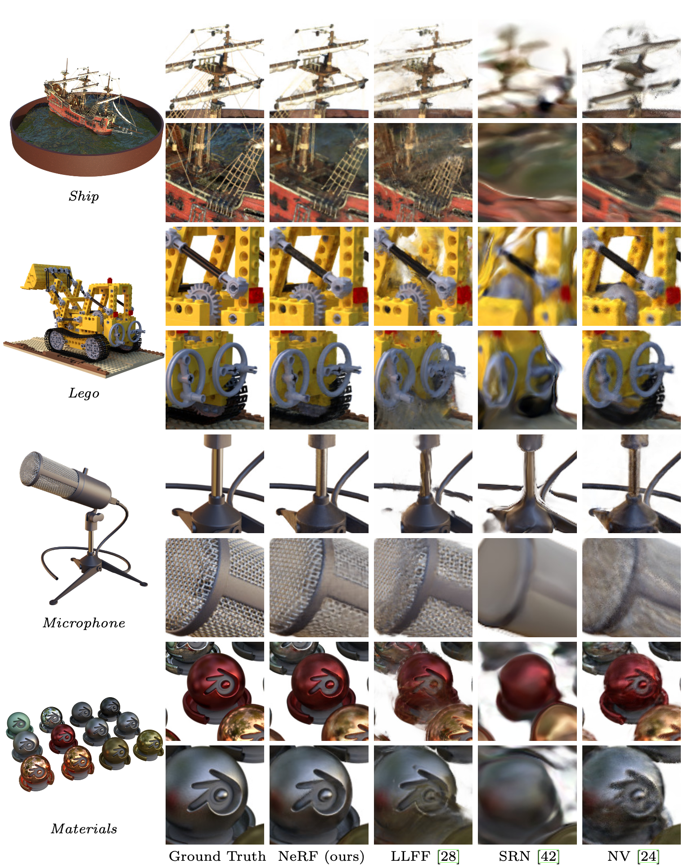
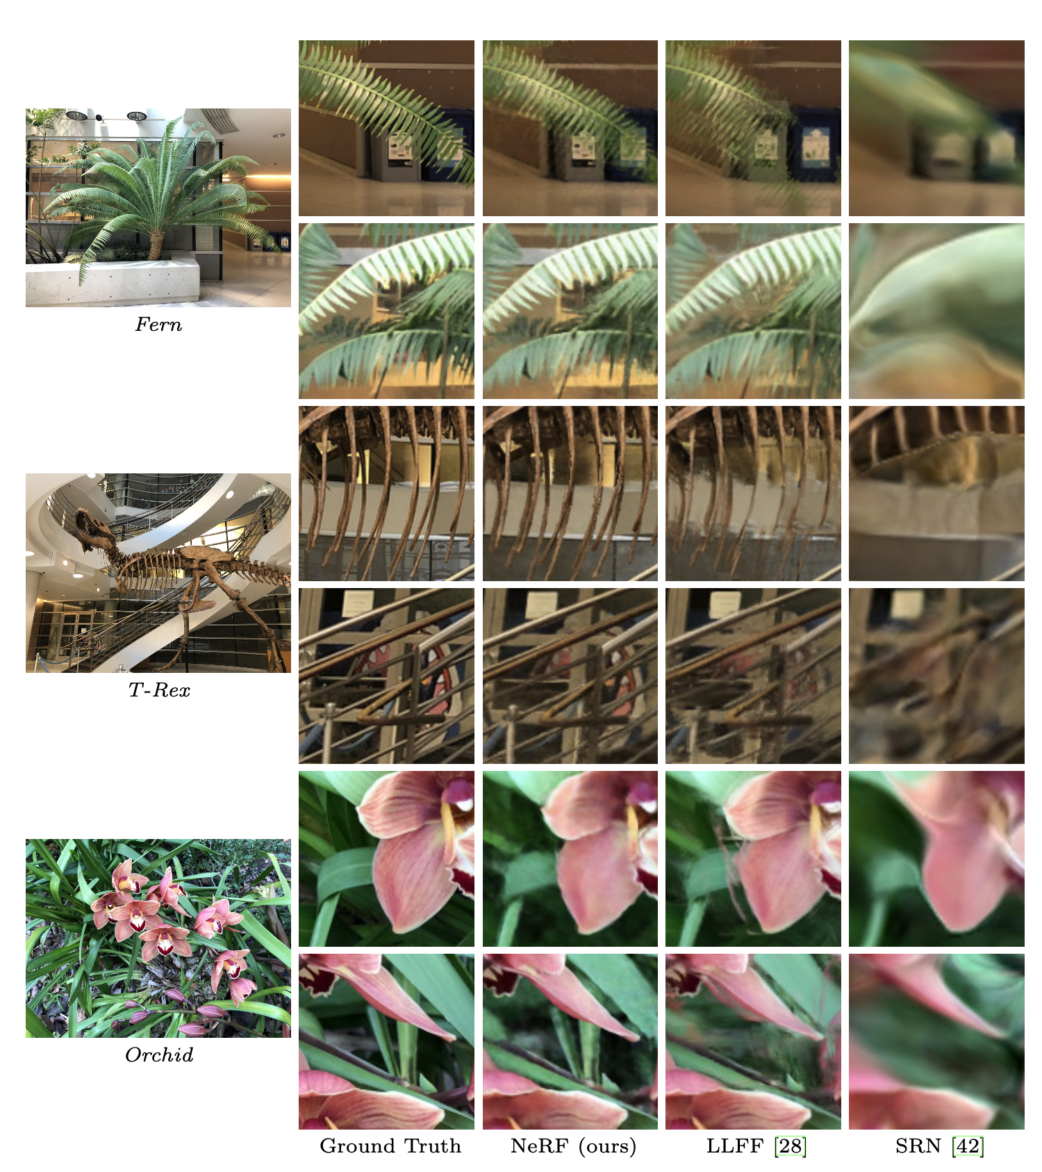

Slide 36
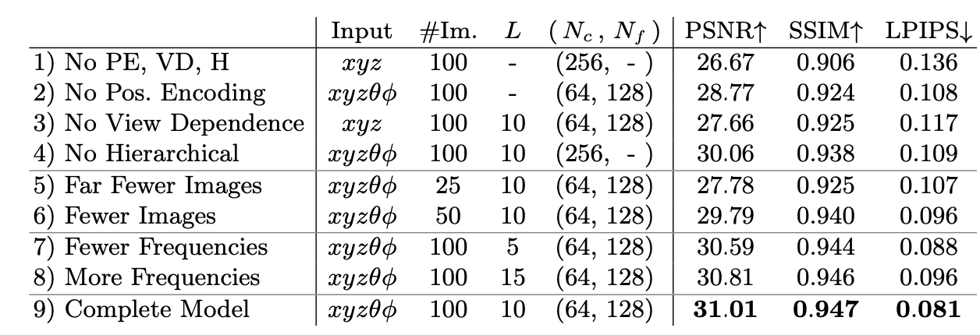
Comparision of optimizations

Slide 37
9. Conclusion
Benefits
Drawbacks
State-of-the-Art model
Generates high-resolution images
Learned on just 25 images still outperfoms other method learned on 100 images
Takes 100-300k iterations to converge on a single NVIDIA V100 GPU (1-2 days)
Has to be trained for every single scene

